Slide 1


Automating Cloud-Native
Azure AKS & Terraform
From Infrastructure to Workload Deployment
Presented by: Ritesh Hegde
Microsoft MVP for Azure & Hashicorp Ambassador
⚙ TERRAFORM AUTOMATION
Notes:
We're here today to talk about how we can move beyond just using cloud-native tools and start truly automating the entire process.
The title of our presentation is Automating Cloud-Native: Azure AKS and Terraform.
This isn't just about deploying containers; it's about establishing a repeatable, reliable pipeline that spans from the foundational infrastructure all the way up to the application workload.
We're focusing on the powerful combination of Azure Kubernetes Service, or AKS, and Terraform's Infrastructure as Code capabilities.
This pairing allows us to define our entire cloud environment ”networking, security, and the cluster itself€”in version-controlled code.
Our goal is to show you how to shift your focus from managing the underlying plumbing to delivering business value through your applications.
Let's start by looking at the challenge that AKS was specifically designed to solve.

Slide 2

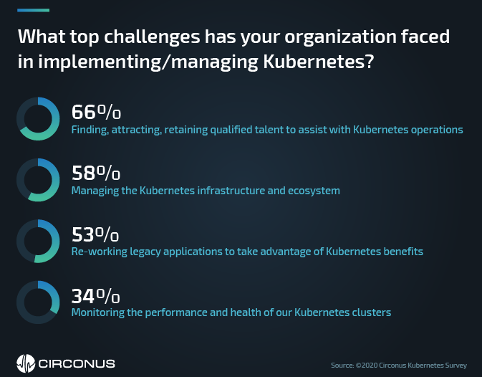
The Kubernetes Challenge
Self-Managed Complexity
Requires deep expertise in installation, configuration, and maintenance of master nodes (API server, etcd, scheduler).
Operational Overhead
Manual patching, upgrades, and high availability setup are constant burdens on operations teams.
Resource Integration
Integrating with cloud resources (networking, load balancers) is often a manual, multi-step process.
The Goal
Focus on application development, not infrastructure management
Notes:
The core challenge in the cloud-native world is that while Kubernetes is incredibly powerful, managing it yourself is complex and time-consuming.
When you choose self-managed Kubernetes, you take on the burden of the control plane.
That means you need deep expertise to handle the installation, configuration, and constant maintenance of the master nodes, the API server, and etcd.
This creates massive operational overhead.
You are constantly patching, upgrading, and ensuring high availability, which pulls your engineers away from developing features.
And integrating the cluster with the rest of your cloud resources ”things like load balancers and networking ”is often a manual, multi-step process that introduces human error.
Ultimately, your team should be focused on application development, not infrastructure management.
This is where a managed service like AKS becomes essential.

Slide 3

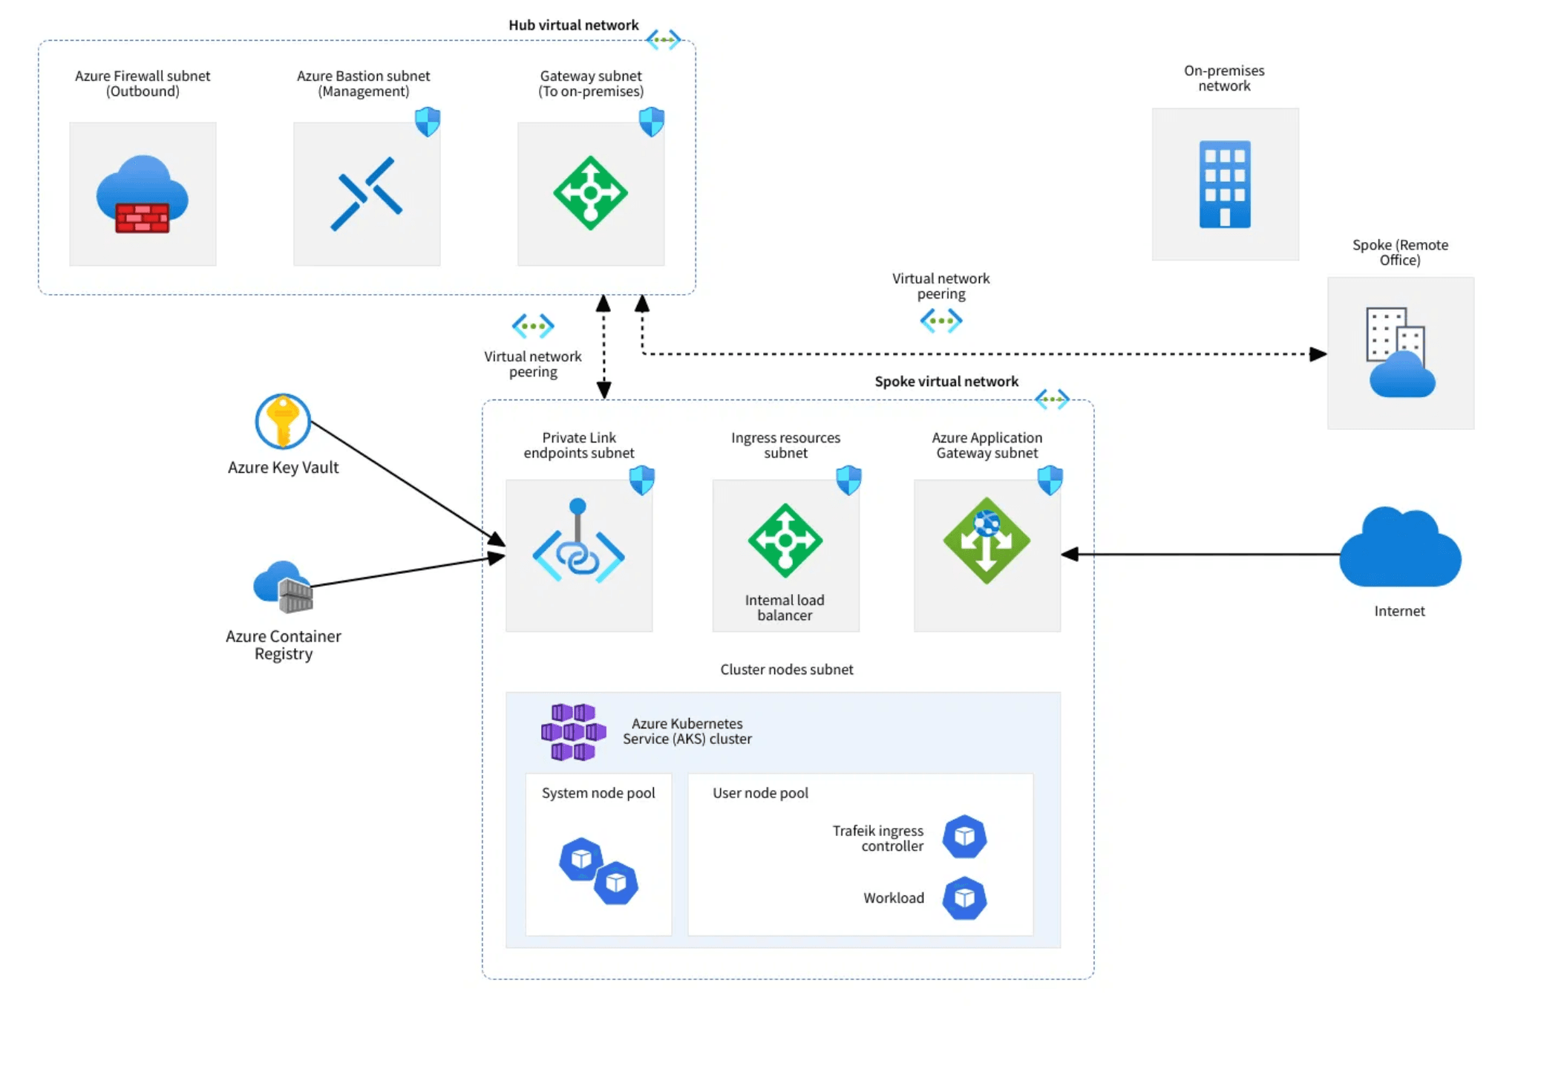
Why Azure Kubernetes Service?
Managed Control Plane
Azure handles the master nodes, including health monitoring, maintenance, and patching.
Zero-Cost Master
You only pay for the worker nodes (VMs) and associated resources.
Seamless Integration
Deep integration with Azure services like Azure AD, Azure Networking, and Azure Monitor.
Open-Source Core
Built on 100% upstream Kubernetes, ensuring portability and avoiding vendor lock-in.
Notes:
So, how do we solve that complexity problem we just discussed? We turn to Azure Kubernetes Service, or AKS, which provides a fully managed solution from Microsoft Azure.
The key benefit is the managed control plane.
Azure handles the heavy lifting of the master nodes, including health monitoring, maintenance, and patching, all behind the scenes.
This is a huge cost saver because you only pay for the worker nodes and associated resources; the master nodes are zero-cost.
AKS also offers seamless integration with the entire Azure ecosystem, connecting easily with Azure AD for identity, Azure Networking, and Azure Monitor.
Crucially, AKS is built on 100% upstream Kubernetes, meaning you get portability and avoid vendor lock-in while benefiting from Azure's operational excellence.
Now let's dive into the specific advantages this managed approach delivers.

Slide 4

AKS Advantages: Operational Efficiency & Security
⚙
🔒
📈
Automated Upgrades
Integrated Security
Elastic Scaling
Operational Efficiency
Security & Compliance
Performance & Cost
Simple, one-click or automated upgrades for Kubernetes versions and node images.
Built-in Azure Policy, Azure AD integration for RBAC, and network security groups.
Native integration with Cluster Autoscaler and HPA for dynamic scaling.
• Zero downtime updates
• Azure AD authentication
• Horizontal pod autoscaling
• Scheduled maintenance windows
• Role-based access control
• Cluster node autoscaling
• Automatic node image patching
• Network policies & NSGs
• Cost-optimized scaling
auto_upgrade_channel = "patch"
identity { type = "SystemAssigned" }
enable_auto_scaling = true
Notes:
AKS delivers significant gains in both operational efficiency and security, allowing your team to focus squarely on your applications.
First, consider automated upgrades. AKS makes Kubernetes version and node image upgrades simple, often with one-click or fully automated processes that minimize downtime.
This is critical for maintaining security and accessing the latest features without the usual pain.
Second, security is integrated from the start. You can enforce compliance using Azure Policy, and use Azure AD integration for robust, fine-grained role-based access control, or RBAC.
Finally, AKS provides elastic scaling out of the box.
It natively integrates with the Cluster Autoscaler and the Horizontal Pod Autoscaler, ensuring your environment scales dynamically to meet demand while optimizing costs.
These features make AKS a highly efficient platform, but the integration doesn't stop there.

Slide 5

AKS Advantages: Azure Ecosystem Integration
Azure AD Integration
Azure Networking
Use corporate identities for cluster access and Kubernetes RBAC for fine-grained access control.
Deploy into custom VNets with Azure CNI for advanced networking and IP address management.
Azure Monitor
Storage Integration
Comprehensive logging and monitoring for cluster and application performance with deep insights.
Use Azure Disks and Azure Files for persistent volume claims and shared storage solutions.
Notes:
Building on the operational benefits, AKS truly shines through its deep integration with the broader Azure ecosystem.
This is where you leverage the full power of the cloud.
We can use Azure AD integration to enforce security by using corporate identities for cluster access and Kubernetes RBAC.
This eliminates managing separate credentials. For networking, you can deploy your cluster into custom VNets using Azure CNI, which gives you advanced IP address management and network control.
Comprehensive observability is handled by Azure Monitor, providing deep logging and monitoring for both the cluster health and your application performance.
And for stateful applications, AKS provides seamless storage integration, allowing you to use Azure Disks and Azure Files for persistent volume claims.
But a great platform needs a great automation tool, which brings us to Terraform.

Slide 6

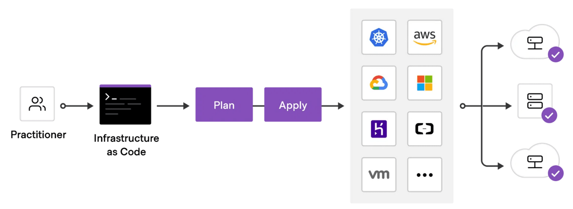
Terraform: Infrastructure as Code
Repeatability
Provision identical environments (Dev, Test, Prod) with a single command.
Version Control
Infrastructure configuration is stored in Git, enabling review, audit, and rollback.
Unified Workflow
Use a single tool to manage all Azure resources, including networking, security, and AKS.
State Management
Securely manage the state of your infrastructure using the Azure Storage Backend.
Notes:
Now that we've seen why AKS is the right managed service, we need the right tool to provision it. That tool is Terraform.
Terraform is our Infrastructure as Code solution, and it's essential for managing the complexity of a Kubernetes environment.
This matters because manual provisioning is slow, error-prone, and impossible to audit.
We need to define our entire AKS environment the VNet, the subnets, the security groups, and the cluster itself all in code.
This gives us repeatability. We can provision identical Dev, Test, and Production environments with a single command, eliminating configuration drift.
And because this code lives in Git, we get version control.
Every change is reviewed, audited, and we can roll back to a previous known-good state instantly.
Finally, Terraform gives us a unified workflow.
We use one tool to manage all Azure resources, not a mix of PowerShell, CLI, and portal clicks. This is the foundation for true automation. So how do we put Terraform and AKS together to get that end-to-end automation?

Slide 7

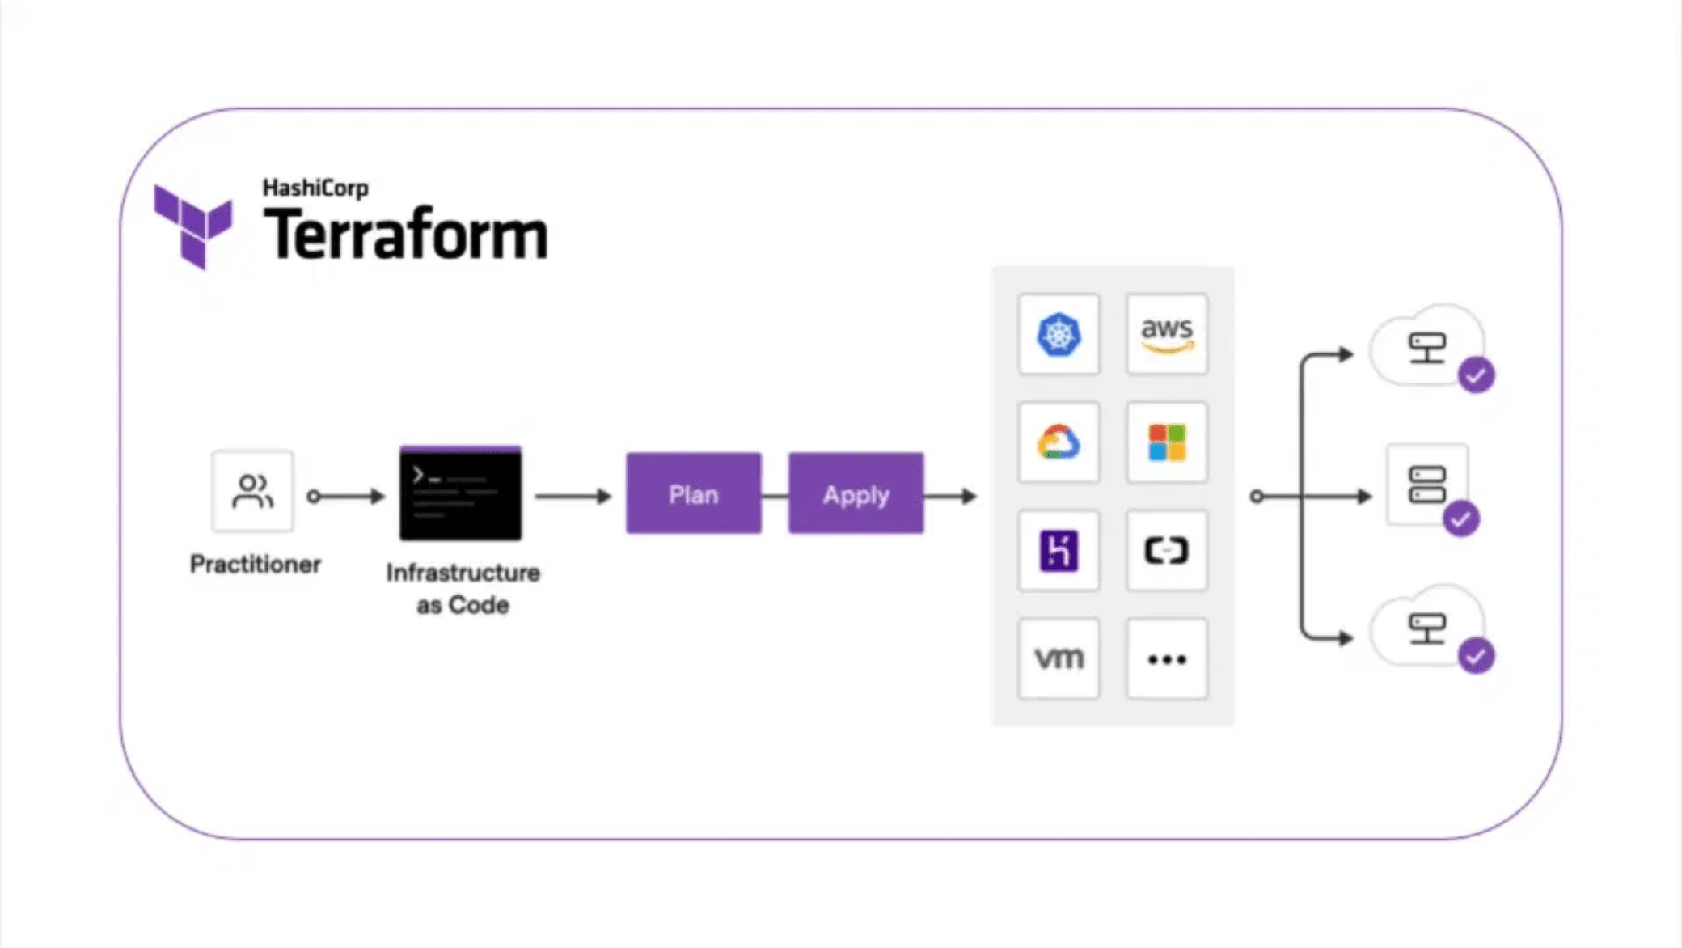
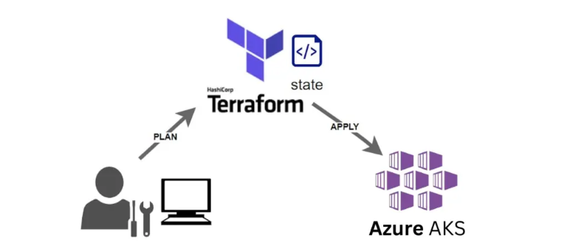
The Terraform & AKS Partnership - End-to-End Automation
Phase 1
Infrastructure Provisioning
Terraform's azurerm provider provisions VNet, Subnets, and the AKS cluster.
↓
Phase 2
Kubernetes Provider Connection
Terraform dynamically connects the kubernetes provider using generated Kubeconfig.
↓
Phase 3
Workload Deployment
The kubernetes provider deploys application resources directly to the cluster.
Result
Fully provisioned and deployed environment in a single terraform apply
Notes:
The real power comes when we combine Terraform's infrastructure provisioning with its ability to deploy workloads onto the cluster it just created.
This isn't two separate processes; it's one seamless workflow.
We break this down into three phases.
Phase one is the infrastructure.
We use the Terraform azurerm provider to provision the VNet, the subnets, and the AKS cluster itself. This is the heavy lifting of cloud resource creation.
Once the cluster is up, we move to phase two.
Terraform dynamically connects to that brand-new AKS cluster using the Kubeconfig file it just generated. This is the crucial handoff.
Then, in phase three, we switch providers.
We use the Terraform kubernetes provider to deploy our application resources our Deployments, Services, and Ingresses directly onto the cluster.
The result is a fully provisioned and deployed environment in a single terraform apply command. This is true end-to-end automation, and it's what makes the Terraform and AKS partnership so powerful. Let's look at a couple of practical examples of where this shines.

Slide 8

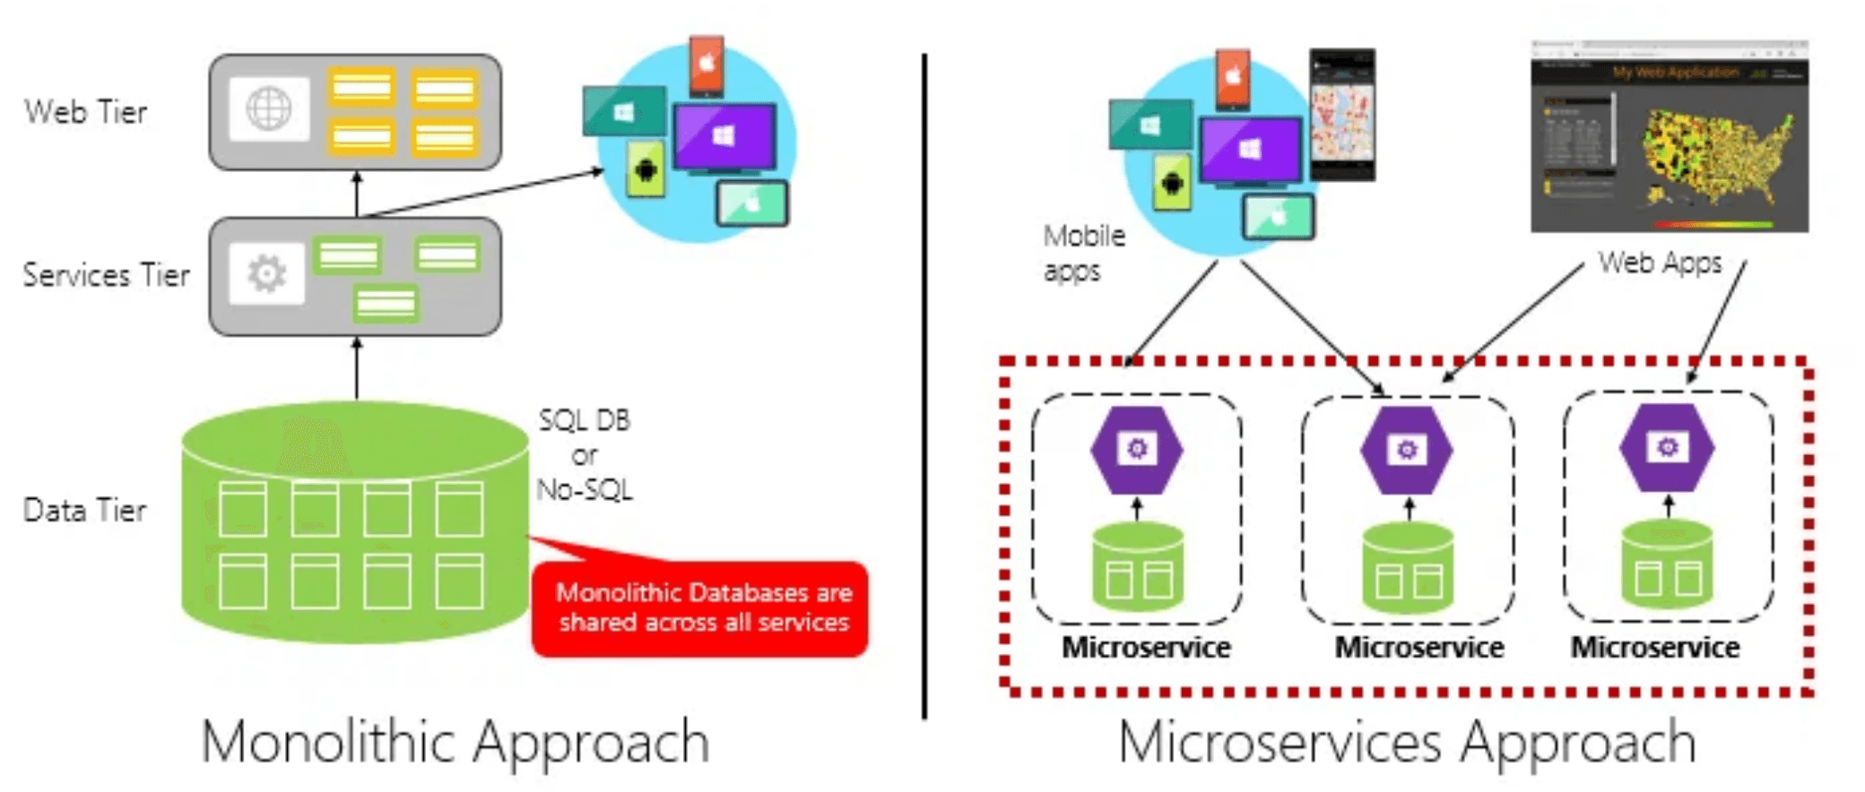
Use Case: Highly Scalable Microservices
AKS Orchestration
Orchestrates hundreds of independent services with built-in service discovery and automatic load balancing.
Terraform Automation
Automates creation of multiple node pools (System, User, GPU) tailored for different microservice needs.
Ingress Management
Integrates with Azure Load Balancer and Application Gateway for advanced routing and traffic management.
Key Benefit
Scale individual services independently without affecting others
Notes:
Our first use case is the highly scalable microservices architecture, which is exactly what Kubernetes was built for.
The challenge here is managing hundreds of independent services that all need to communicate, scale, and be discovered reliably.
AKS provides the orchestration layer for this, handling service discovery, load balancing, and health checks automatically.
But Terraform's role is critical in tailoring the underlying infrastructure.
We use Terraform to automate the creation of multiple node pools.
For example, we can have a System node pool for core services, a User node pool for standard applications, and maybe a GPU node pool for machine learning workloads.
This fine-grained control ensures optimal resource utilization and cost management.
And because AKS integrates seamlessly with Azure Load Balancer and Application Gateway, Terraform can provision those ingress controllers right alongside the cluster, giving us advanced routing and traffic management from day one.
This allows us to scale individual services independently without affecting the rest of the architecture. Now, let's look at a different kind of use case: migrating legacy systems.

Slide 9

Use Case: Lift-and-Shift Cloud Migration
1
Application Modernization
Containerize Existing Applications
Package legacy monolithic applications into Docker containers for cloud deployment.
↓
• Preserve application logic and dependencies
• Minimal code refactoring required
• Rapid time-to-cloud deployment
2
Infrastructure Automation
Terraform Provisions Target Environment
Rapidly provision the entire cloud infrastructure including VNet, AKS cluster, and managed databases.
• VNet and subnet configuration
↓
• AKS cluster with multiple node pools
• Azure Database for PostgreSQL/MySQL
3
Cloud-Native Transformation
Focus on Refactoring & Modernization
AKS reduces operational burden, freeing teams to refactor applications for cloud-native patterns.
• Microservices decomposition
• Serverless integration patterns
• Cost optimization strategies
✓
Key Advantage
Rapid migration path from legacy infrastructure to cloud-native architecture with minimal operational overhead
Notes:
The second common use case is the lift-and-shift migration, where we're moving existing applications to the cloud quickly.
The first step is application modernization:
we containerize the legacy application. We package the monolithic application into Docker containers, preserving the application logic with minimal code refactoring. This gives us a rapid time-to-cloud deployment.
The second step is infrastructure automation.
Terraform creates the entire target environment in minutes. This includes the VNet, the AKS cluster, and any necessary managed databases like Azure Database for PostgreSQL or MySQL. This speed and reliability are key to a successful migration project.
Finally, this sets us up for cloud-native transformation. AKS handles the operational burden, allowing the development team to focus on refactoring the application into microservices or integrating serverless patterns.
The key advantage here is a rapid, reliable migration path from legacy infrastructure to a modern, cloud-native architecture with minimal operational overhead. But as we start managing more complex infrastructure, we need to talk about a critical best practice: state management.

Slide 10

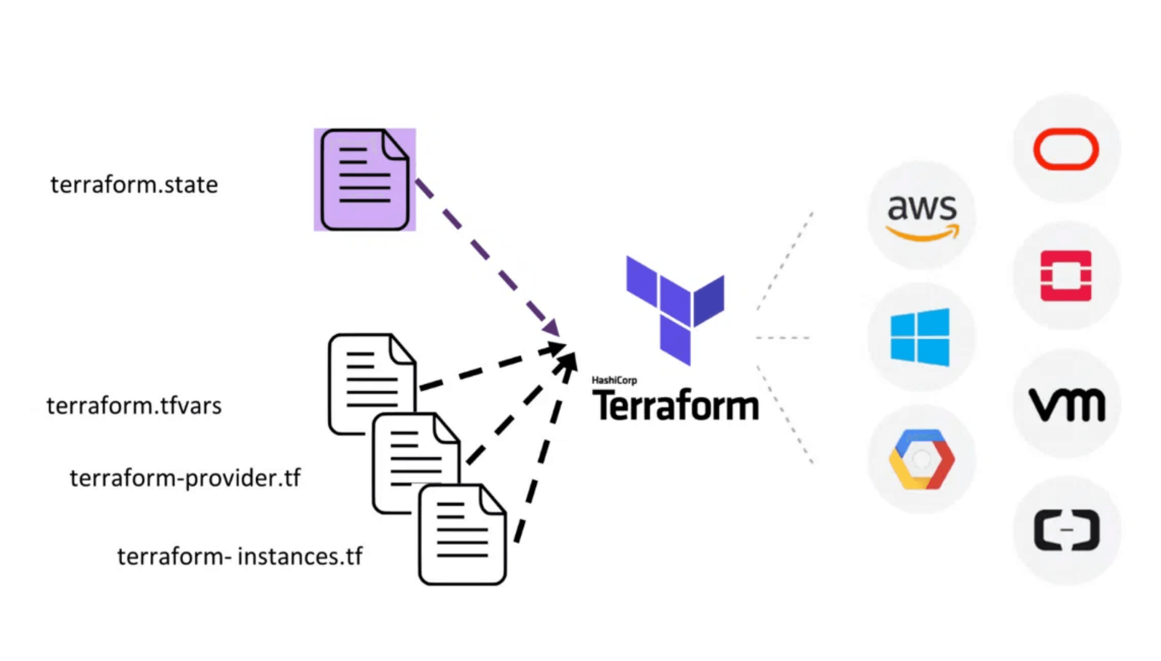
Best Practice: Remote State
The Problem
Local state files are prone to loss and accidental deletion.
Concurrent updates by multiple users cause state corruption.
The Solution
Use Azure Storage Account as a remote backend for centralized, secure state management.
Key Benefits
State Locking
Encryption
Prevents simultaneous updates by multiple users.
State stored securely with encryption at rest.
Collaboration
Audit Trail
Multiple team members can work on same infrastructure.
Track all changes and maintain compliance records.
Notes:
When working with Terraform, the state file is the single source of truth for your infrastructure.
But relying on a local state file is a recipe for disaster. Local files are prone to loss, and concurrent updates by multiple team members will corrupt your state, causing major outages.
The solution is simple and non-negotiable: use a remote backend.
We recommend using an Azure Storage Account for this.
This immediately solves several problems.
First, we get state locking, which prevents simultaneous updates by different users, ensuring integrity.
Second, the state is stored securely in Azure, encrypted at rest, meeting most compliance requirements. And most importantly, it enables collaboration. Multiple team members can safely work on the same infrastructure, which is essential for any DevOps team. This remote state is the foundation for secure, collaborative infrastructure management. But state is only one part of the puzzle; next, we need to talk about making our code reusable with modules.

Slide 11

Best Practice: Terraform Modularity
Environment 1
Environment 2
Environment 3
Development
Testing
Production
node_count = 2
node_count = 3
node_count = 5
vm_size = Standard_B2s
vm_size = Standard_D2s_v3
vm_size = Standard_D4s_v3
env = "dev"
env = "test"
env = "prod"
↑
aks-cluster Module
Reusable, parameterized resource definition
↓
Code Reuse
Organizational Standards
Maintainability
Single module definition deployed across multiple environments with only variable changes.
Enforce consistent configurations and best practices across all deployments.
Update module once and all environments automatically benefit from improvements.
Notes:
After securing our state, the next best practice is enforcing modularity. This is where we stop repeating ourselves and start treating our infrastructure code like software. The core idea is to encapsulate complex resource definitions, like an entire AKS cluster, into a single reusable module. We define the cluster once in the aks-cluster module, complete with all the networking and security configurations we want to enforce. Then, we simply call that module multiple times for different environmentsâ€”Dev, Test, and Prodâ€”changing only the variables. This approach drastically reduces code duplication and ensures that every environment, from the smallest Dev cluster to the largest Prod cluster, adheres to the exact same organizational standards and best practices. If we need to update a security setting, we update the module once, and all environments inherit that change automatically. This is the key to scaling IaC across large organizations. Now that we've covered the best practices for managing our Terraform code, let's pivot back to the core product and look at the fundamental difference between AKS and self-managed Kubernetes.

Slide 12

AKS vs Self-Managed Kubernetes: The Comparison
Self-Managed Kubernetes
Azure Kubernetes Service (AKS)
Infrastructure
Infrastructure
You provision and manage all infrastructure (VMs, networking, storage)
Azure manages infrastructure; you only manage worker nodes
Control Plane
Control Plane
You install, configure, and maintain all control plane components
Azure fully manages control plane; you focus on applications
Complexity
Simplicity
High operational complexity requiring specialized DevOps expertise
Low operational complexity with managed service model
Updates & Patches
Updates & Patches
Manual management of Kubernetes version upgrades and security patches
Automatic updates with zero-downtime patching and upgrades
Notes:
We've spent a lot of time talking about AKS and Terraform, but let's pause and clearly define why we choose the managed service model in the first place.
The comparison between AKS and self-managed Kubernetes boils down to a fundamental choice: do you want to be a Kubernetes operator or an application developer?
With self-managed Kubernetes, you are responsible for everything. You provision the infrastructure, you install and configure the control plane components, and you manually manage all updates and security patches. This results in high operational complexity and requires deep, specialized DevOps expertise just to keep the lights on.
AKS flips this model completely. Azure manages the underlying infrastructure and the entire control plane for you. You only manage the worker nodes and your applications. This dramatically lowers the operational complexity and provides automatic updates and patching, allowing your team to focus 100% on delivering business value through your applications. This distinction is critical, and it leads us directly to the concept of the responsibility model.

Slide 13

Control Plane vs Data Plane: Responsibility Model
Azure Managed
Control Plane (Kubernetes Master)
API Server
etcd
Scheduler
Exposes Kubernetes API for cluster management and communication
Distributed key-value store for cluster state and configuration
Assigns pods to nodes based on resource requirements and policies
+ Controller Manager, Cloud Controller Manager, DNS Service
Responsibility Boundary
Data Plane (Worker Nodes)
Customer Managed
Worker Nodes
Kubelet
Container Runtime
Virtual machines running containerized applications
Node agent ensuring containers run in pods
Docker, containerd, or other container execution engine
+ kube-proxy, Network plugins, Storage volumes
Notes:
Understanding the difference between the Control Plane and the Data Plane is essential for grasping the value of AKS.
The Control Plane is the brain of the cluster; it includes the API Server, etcd, and the Scheduler. These components manage the cluster state, handle all API requests, and decide where pods should run.
In AKS, Azure fully manages this entire Control Plane. They handle the high availability, the patching, and the monitoring, and you don't pay for the VMs running these components.
The Data Plane, on the other hand, is the muscle. This is where your applications actually run on the Worker Nodes. These nodes are the VMs you provision and pay for, and you manage the applications running on them.
The clear responsibility boundary is the core value proposition of AKS. Azure takes on the heavy, undifferentiated lifting of the Control Plane, freeing your team to focus entirely on optimizing the Data Plane for your specific workloads. This division of labor has a massive impact on the complexity of your deployment and configuration files.

Slide 14

Deployment & Configuration: AKS vs Self-Managed
Self-Managed Kubernetes
Azure Kubernetes Service (AKS)
kubeadm-config.yaml
main.tf
Control plane initialization configuration
Single Terraform file defining entire cluster infrastructure
worker-setup.sh
variables.tf
Worker node provisioning and setup scripts
Parameterized configuration for customization
networking-config.yaml
outputs.tf
CNI plugin and network policy configuration
Cluster access information and credentials
security-policies.yaml
terraform.tfvars
RBAC, pod security policies, network policies
Environment-specific variable values
monitoring-stack.yaml
Prometheus, Grafana, and logging setup
✓ Control plane: Managed by Azure ✓ Networking: Integrated with Azure VNet ✓ Security: Azure AD, RBAC, NSG ✓ Monitoring: Azure Monitor built-in ✓ Backup: Automatic snapshots
backup-strategy.yaml
etcd backup and disaster recovery configuration
Configuration Files
20+
Configuration Files
4
Notes:
When we look at the actual configuration files required, the complexity difference between the two models becomes starkly apparent.
Deploying a self-managed Kubernetes cluster is a multi-step, multi-file process.
You need separate configuration files for the control plane initialization, the worker node setup scripts, the CNI plugin, security policies, and don't forget the monitoring and backup strategies.
You are easily looking at twenty or more distinct configuration files just to get a production-ready cluster up and running.
Compare that to AKS deployed with Terraform.
We use a single main.tf file to define the entire cluster infrastructure. The control plane, networking, security, and monitoring are all integrated and managed by Azure.
We simply define the desired state of our worker nodes and our Azure integrations.
This reduction from twenty-plus configuration files to just four core Terraform files represents a massive simplification in your infrastructure management, reducing the surface area for errors and increasing deployment speed.
This simplification directly translates into reduced operational overhead, which is what we'll examine next.

Slide 15

Operational Overhead: AKS Advantage
Operational Task
Self-Managed
AKS
Control Plane Upgrades
✗
✓
Security Patch Management
✗
✓
etcd Backup & Recovery
✗
✓
High Availability Setup
✗
✓
Disaster Recovery
Monitoring & Alerting
✗
✓
Cluster Scaling
✗
✓
✗
✓
✗
Customer Responsible
✓
Azure Responsible
Notes:
This comparison really drives home the core value proposition of AKS: shifting the operational burden from your team to Azure.
When we look at self-managed Kubernetes, every single operational task—from control plane upgrades to etcd backup and recovery—falls squarely on your DevOps team.
That requires specialized, expensive expertise and constant vigilance.
But with AKS, Azure takes responsibility for the entire control plane.
This means automatic security patching, guaranteed high availability, and seamless disaster recovery are all handled for you.
Think about the time savings. You're not spending cycles troubleshooting etcd clusters or manually applying security patches.
You're focusing that engineering talent on building and deploying features that actually drive business value.
This is the difference between being an infrastructure operator and being a product innovator. So, the operational advantage is clear,
but let's look at how this translates directly into dollars and cents.

Slide 16

Cost & Support: Total Cost of Ownership
Self-Managed Kubernetes
Azure Kubernetes Service (AKS)
Infrastructure Costs
$$$
AKS Service Costs
$
DevOps Engineers (2-3 FTE)
$$$
DevOps Engineers (0.5-1 FTE)
$
Training & Certification
$$
Training & Certification
$
Support & Consulting
$$
Enterprise Support
$
Tools & Monitoring
$$
Tools & Monitoring
$
Annual TCO
Annual TCO
$500K - $1M+
$100K - $300K
Key Benefits
Reduced staffing needs, predictable costs, enterprise SLA, automatic updates, zero-
downtime upgrades
Notes:
The operational overhead we just discussed has a direct and significant impact on your total cost of ownership, or TCO.
Self-managed Kubernetes requires a massive investment in infrastructure costs, but the real expense is the human capital.
You need multiple dedicated, highly-paid DevOps engineers just to keep the lights on and manage that complexity. We're talking about an annual TCO that can easily exceed half a million dollars, sometimes much more.
Now compare that to AKS. While you still have infrastructure costs for the worker nodes, the staffing requirement drops dramatically. You're shifting from two or three full-time engineers dedicated to cluster maintenance to perhaps one engineer focused on optimization and application deployment. This results in a much lower, more predictable TCO.
The key benefit here is the enterprise-grade SLA and automatic updates that come with AKS, which drastically reduces your risk and your staffing needs. This financial model is a powerful argument for making the switch. Now let's wrap up everything we've covered today and look at your next steps.

Slide 17

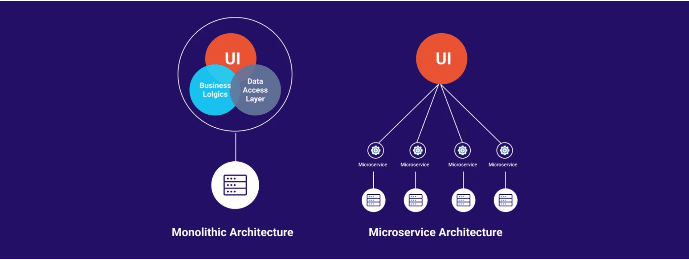
Summary: Cloud-Native Automation Achieved
AKS Advantage
Eliminates the operational burden of managing the Kubernetes control plane.
Terraform Advantage
Provides version-controlled, repeatable infrastructure automation across all environments.
Combined Power
Together they enable true end-to-end automation from infrastructure to application deployment.
Next Steps
1. CI/CD Pipeline
2. Observability
3. Production Ready
Explore Azure DevOps or GitHub Actions for automated deployment pipelines.
Implement Azure Monitor and Prometheus/Grafana for deep cluster and application insights.
Start building your first AKS cluster with the provided Terraform code and best practices.

Slide 18



Thank You!
Would you like to connect?
Linkedin
GitHub
Youtube

